Slide 1

High G Flocculation
Roswell Lo, Mehrin Selimgir, Kanha Matai
Optimizing Flocculation
More at https://github.com/AguaClara/
Research | Symposium Spring 2018
Notes:
Previously, the High G team designed an experimental setup to test the effects of velocity gradient on flocculator performance. Specifically the team sought to determine an optimal G value through effluent turbidity results.
For this semester, the team aspires to continue to conduct experiments to conclude on an optimal G value. Additionally, the team seeks to evaluate the use of hydrophobic tubing to minimize headloss, assess whether headloss can be mitigate through a sudden, short increase in pump speed, and overall to determine a relationship between coagulant dose and optimal G. As of now, our team has concluded that hydrophobic tubing does not significantly mitigate headloss.
[[Add a link to your full report here. ]]
https://github.com/AguaClara/high_g_flocculation/blob/master/HighGFlocculationSpring2018draft.md

Slide 2
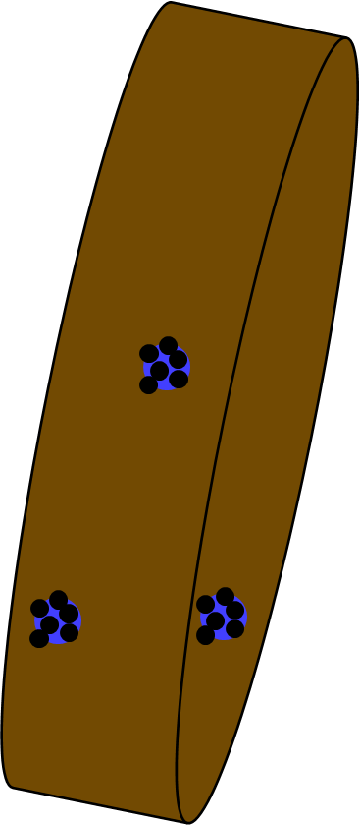
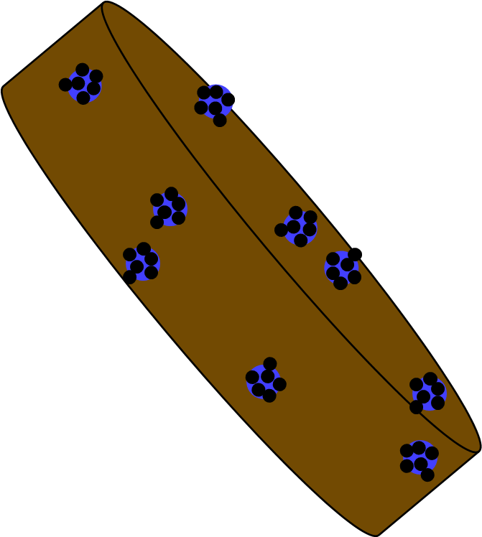



Background
Clay particles aggregate to form flocs in flocculator
Flocs at critical size settle more easily in sedimentation tank.
We want as many flocs as possible to be above a critical size.
High G Flocculation | Research | Symposiums Spring 2018
Notes:
Citations: Cornell CEE 4540 lecture slides: Flocculation Model, retrieved October 15th 2017
Caption: Coagulant-coated clay particles collide together to form flocs that are easier to remove through sedimentation
Summary: We need floc to be big enough to settle in the sedimentation tank easily with the current design.

Slide 3
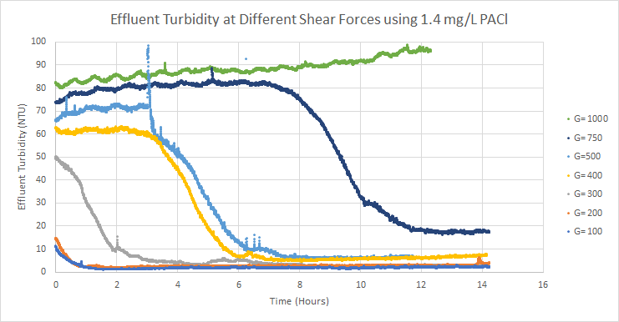
Background
Last semester, High G researched optimal values of G
Shear forces above 100 Hz had higher effluent turbidity
Higher G’s ≠ Better Removal
High G Flocculation | Research | Symposiums Presentation Spring 2018
Notes:
High G Tested G values from 100 -1000.
Cite your sources here.
Caption your figure and explain its relevance to your presentation/thesis here. You can take the caption from your Final Report and modify it.
Write a summary of this slide here. A future team member or client should be able to read this note and understand this slide without having your team explain it to them.
If there are any appendix slides that are relevant to this slide, mention it in your notes.

Slide 4
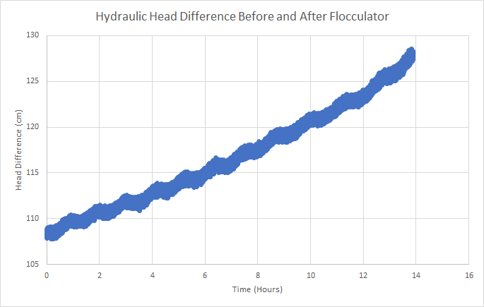
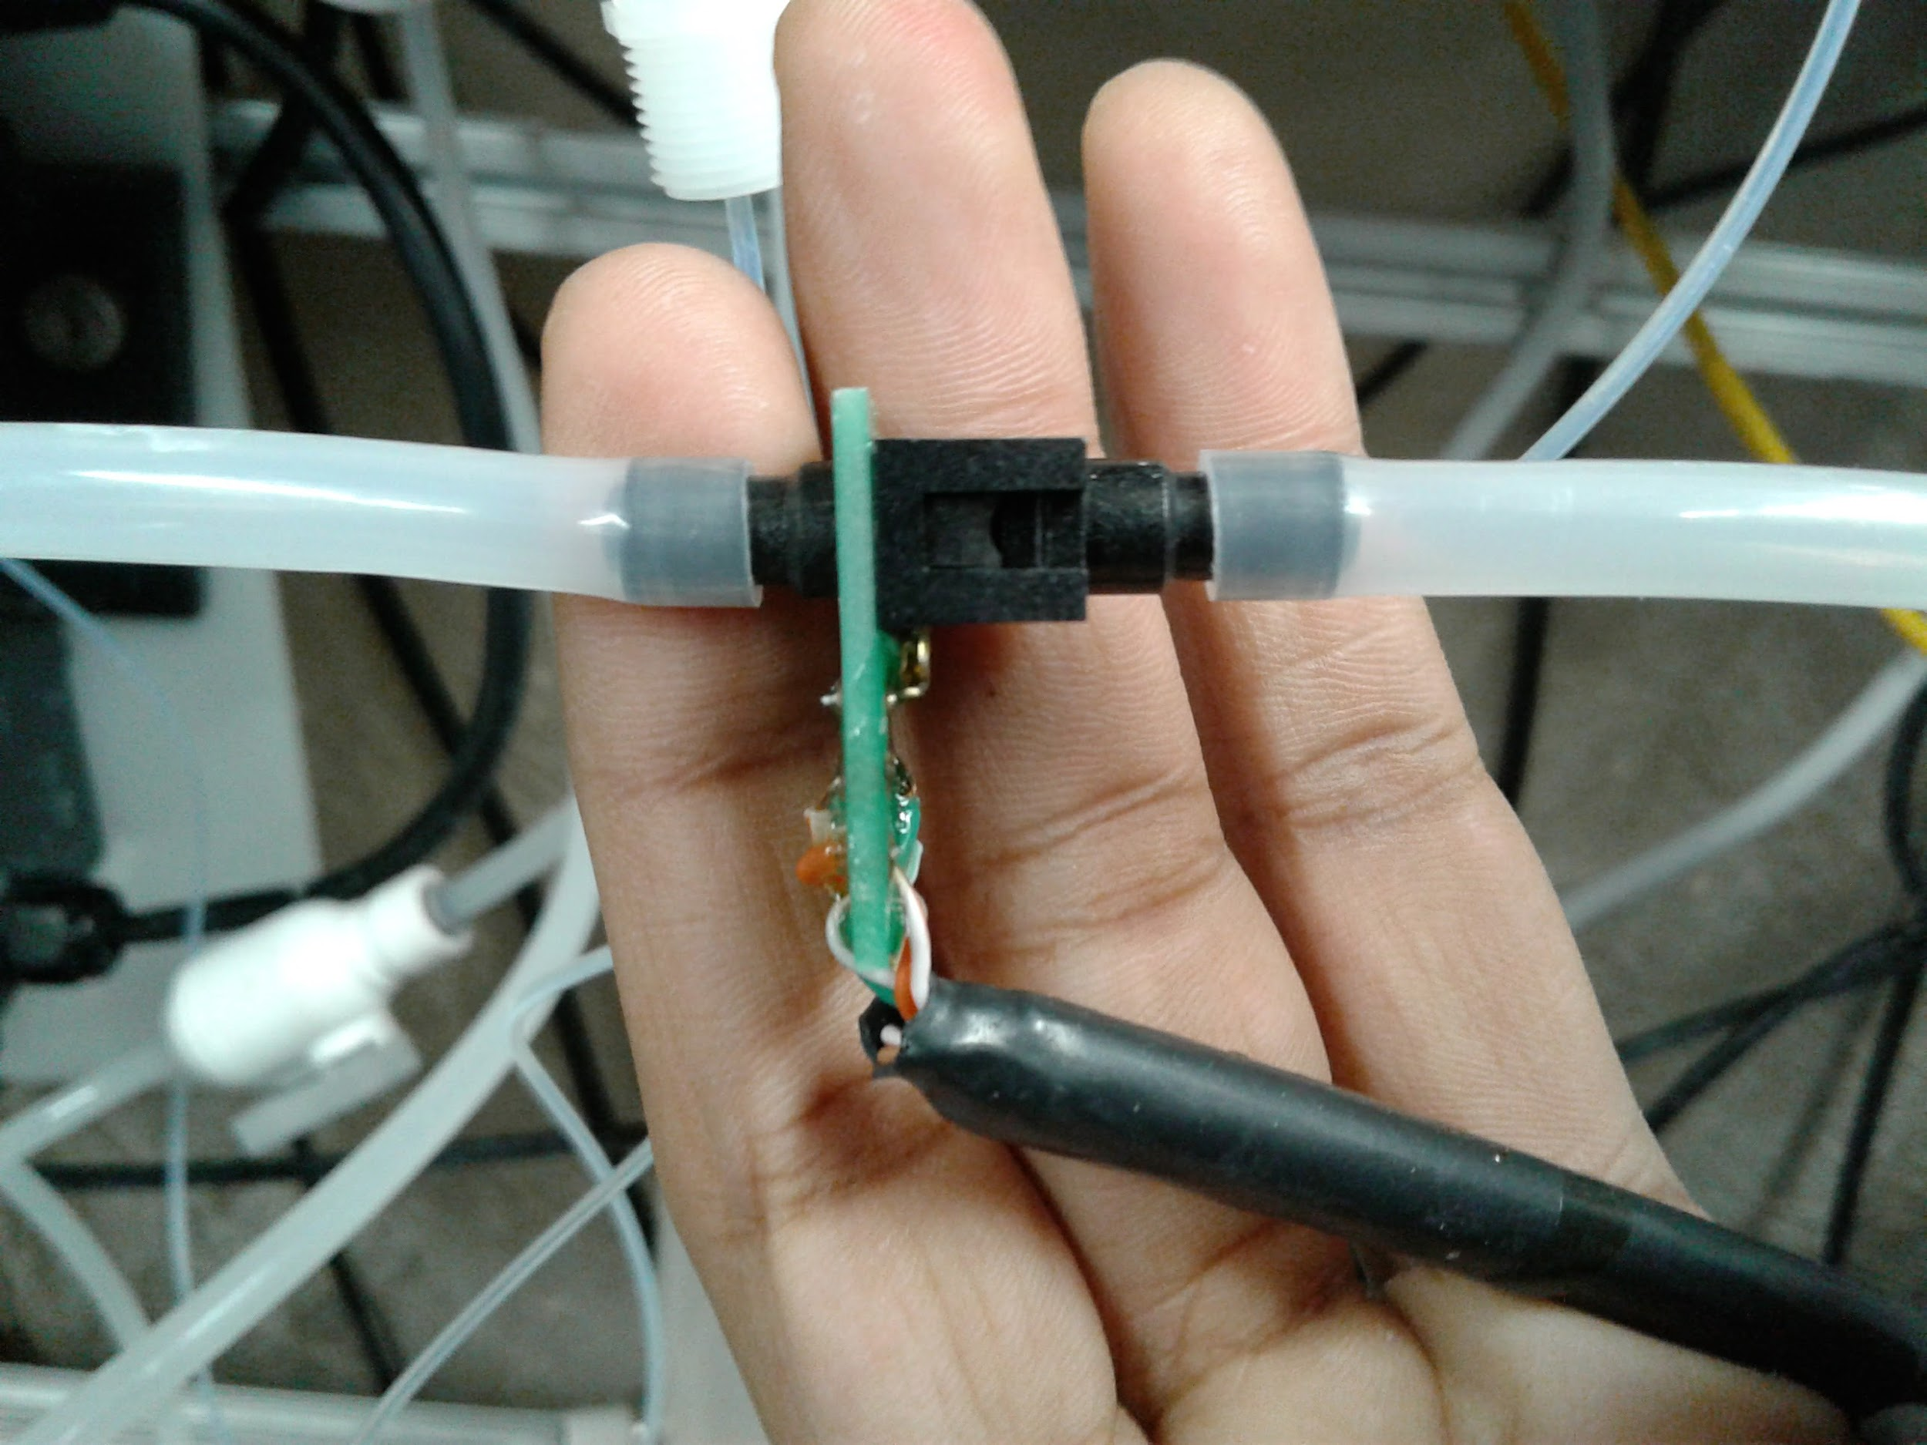
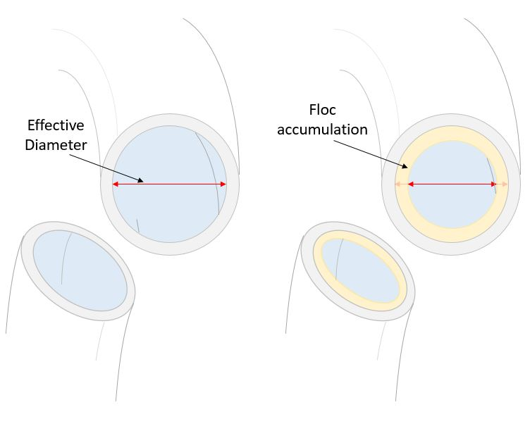
Background
Pressure Increased Throughout our experiments
High G Flocculation| Research | Symposiums Presentation Spring 2018
Notes:
We put a pressure sensor in our experiment to measure pressure difference in our experiment.
Higher pressure resulted in higher actual G, than our recorded ‘theoretical G’ based our pump speed.
Result was an increase of headloss from 108- 128 in 14 hours.
Image sources:
Sensor : https://www.overleaf.com/docs/11255738dpvxbmdstjqx/atts/66072875 from 2017 Fall High G flocculation
Graph : https://www.overleaf.com/docs/11255738dpvxbmdstjqx/atts/66202868 from 2017 Fall High G Flocculation
Accumulation schematic:

Slide 5
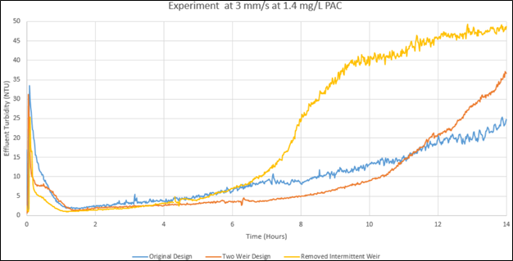
Background
Pressure increase is a problem in our particle removal research!
High G Flocculation| | Research | Symposiums Presentation Spring 2018
Notes:
At 3 mms , High Rate Sed’s research team saw their floc blanket decay and their effluent turbidity increase throughout their experiment.
Graph from High Rate Sedimentation team Fall 2017.

Slide 6
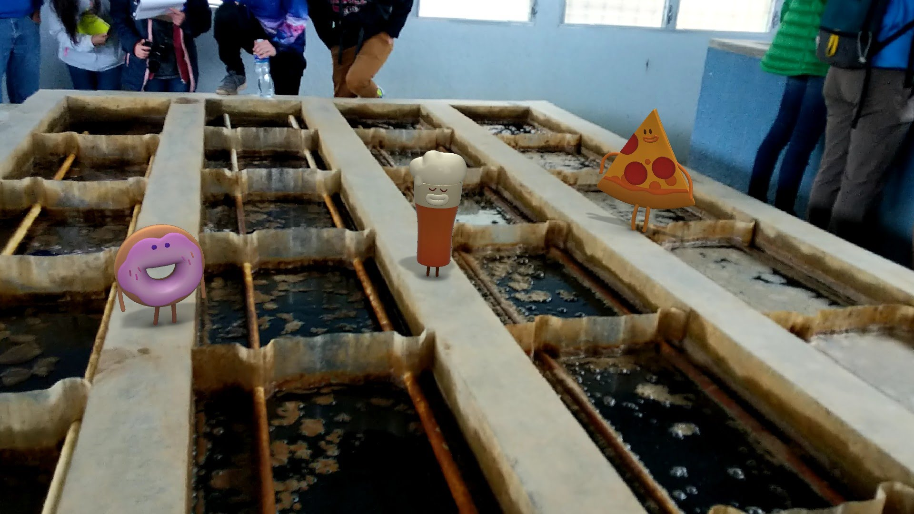
Background
Pressure increase in flocculator tubing is an issue that affects particle removal teams, although not our AguaClara flocculators.
High G Flocculation | Research | Symposiums Presentation Spring 2018
Notes:
Due to the width/ volume of AguaClara flocculators, coagulant buildup on walls will not have any significant impact on actual AguaClara plants.
Caption your figure and explain its relevance to your presentation/thesis here. You can take the caption from your Final Report and modify it.
Write a summary of this slide here. A future team member or client should be able to read this note and understand this slide without having your team explain it to them.
If there are any appendix slides that are relevant to this slide, mention it in your notes.

Slide 7
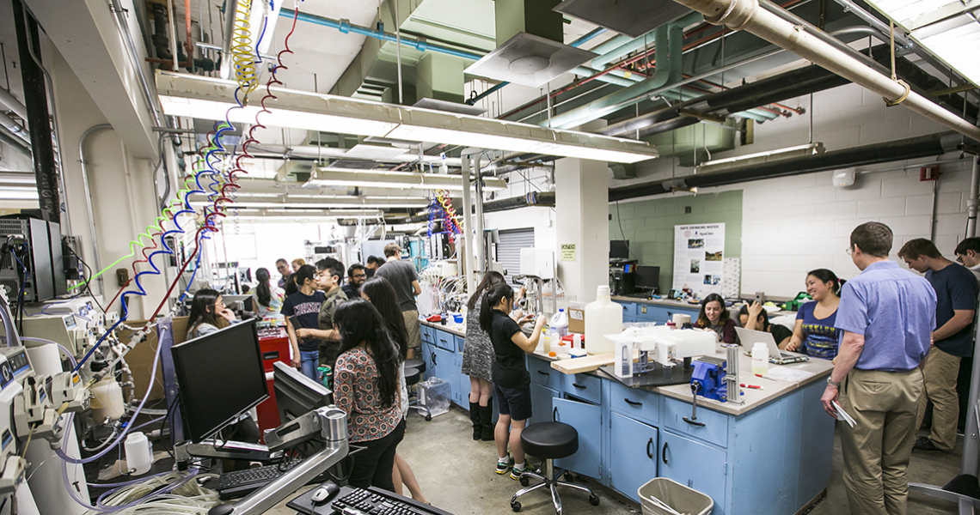
Goals for This Semester
New flocculator design= better particle removal research!
Aid in becoming more open-sourced!
Find that optimal G!
High G Flocculation | Research | Symposiums Presentation Spring 2018
Notes:
Image source:https://research.cornell.edu/content/aguaclara-0
AguaClara Design Lab. Where all the action occurs!
Last semester’s research has shown that the tube flocculator that all of the research teams are using is causing a decrease in performance as a function of time. There is also an increase in head loss across the flocculator as a function of time; thus it was hypothesized that coagulant nanoparticles are attaching to the flocculator walls. Thus an increasingly large fraction of the coagulant nanoparticles are hypothesized to be lost to the flocculator walls and this has the effect of decreasing the coagulant nanoparticle coverage of the clay particles. Our top priority for this semester is to experiment & evaluate solutions to this wall loss of coagulant nanoparticles through the use of hydrophobic tubing.
Also we seek to aid in AguaClara’s transition towards becoming more open-sourced by translating our relevant MathCAD calculations in Python. So far we’ve translated our PaCl coagulant dosing calcs and floc design calcs (See Appendix 1 & 2) into Python.
Also building off last semester’s research, we aim to continue conducting experiments to determine an optimal G value for flocculators.

Slide 8
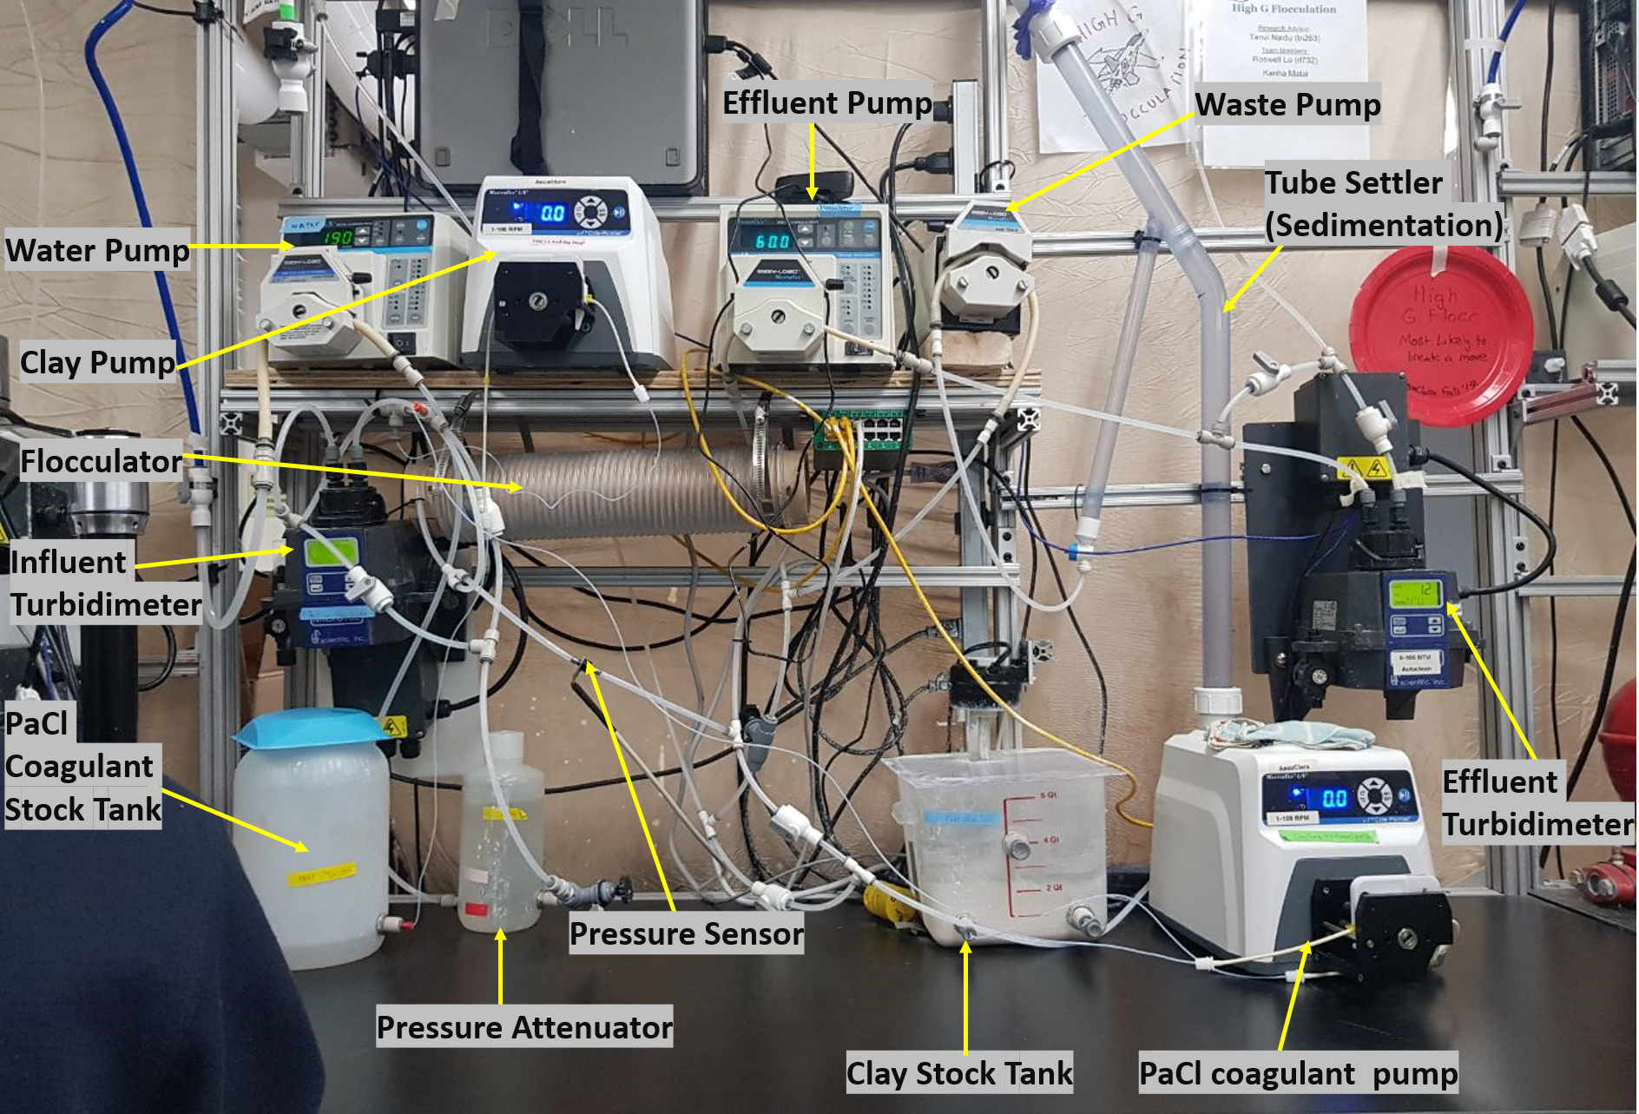
Experimental Setup
High G Flocculation | Research | Symposiums Presentation Spring 2018
Notes:
Image Source:https://github.com/AguaClara/high_g_flocculation/blob/master/HighGFlocculation_Spring2018_ResearchReport.md
High G Experimental Apparatus. An annotated photo of our experimental setup.
This setup takes a mixture of water, clay, and coagulant through a tube (hydrophobic & regular) flocculator, and has the clay settle as flocs in the tube settler. A total of five pumps are required in this setup.
The first of these is the water pump, which is used to vary the velocity of clay solution flowing through the flocculator, and therefore to vary G in a controlled manner.
The next two pumps are used to keep the concentrations of added clay and coagulant at a known and constant value.
The fourth is used to ensure that the upflow velocity within the tube settler is kept at 2 mm/s, as requested by the HRS subteam last semester. (See appendix 3)
The fifth and final pump is used to ensure that settled floc particles in the tube settler exits the system without clogging the tubes.
Measurements taken by the two turbidimeters will be used to determine the effectiveness of the different velocity gradients.
If there are any appendix slides that are relevant to this slide, mention it in your notes.

Slide 9
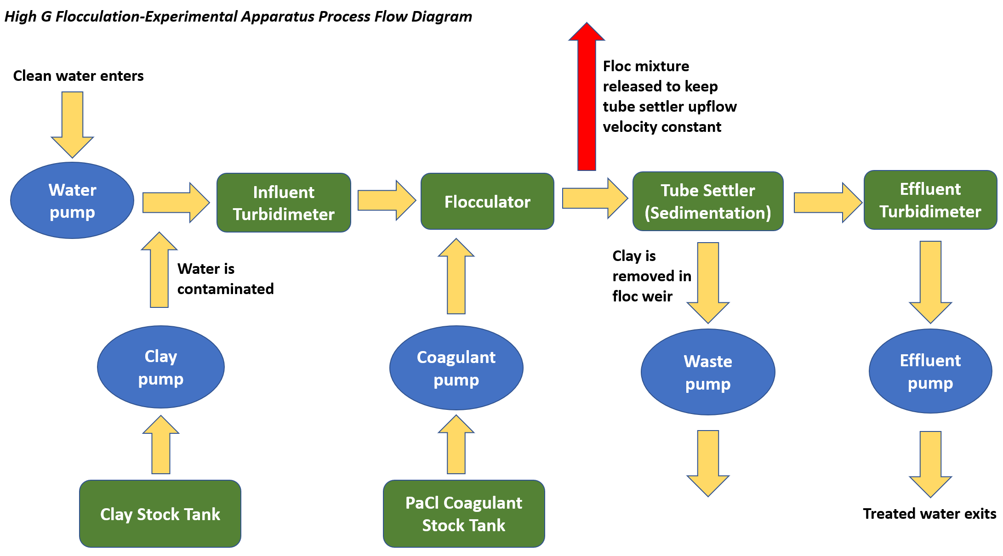
Trial Process Flow Diagram
High G Flocculation | Research | Symposiums Presentation Spring 2018
Notes:
Image Source:https://github.com/AguaClara/high_g_flocculation/blob/master/HighGFlocculation_Spring2018_ResearchReport.md
High G Flocculation Process Flow Diagram. An overall PFD showing the general flow of each experimental trial.
The following is a general outline of the team's experimental setup.
The water pump is used to vary the velocity of influent stream through the flocculator,and therefore varies G in a controlled manner.
The clay pump contaminates clean water with a well-mixed clay solution. The pump and influent turbidimeter together used PID control to maintain a constant influent turbidity of 100 NTU.
The PaCl coagulant pump introduces PaCl coagulant to the well-mixed clay-water solution. The clay-water solution enters the flocculator where clay particles collide and aggregate to form large flocs.
To account for the difference in flow between the water pump and the effluent pump, a wastestream between the flocculator and sedimentation tube is introduced to maintain a constant up flow velocity through the sedimentation tube. The sedimentation tube is an apparatus that is intended to mimic the function of a sedimentation tank in a full-scale treatment plant.
The flocs enter the bottom of the tube settler. The larger and denser particles settle out and are carried out to the waste stream.
The treated water, passing through the tube settler, exits the top and enters the effluent turbidimeter and are subsequently carried out through the waste stream.
The waste pump acts to ensure that settled flocs in the tube settler exit the system without clogging the tubes.
The effluent pump ensures that the upflow velocity within the tube settler is kept at 2 mm/s, as recommended by the High Rate Sedimentation subteam.

Slide 10
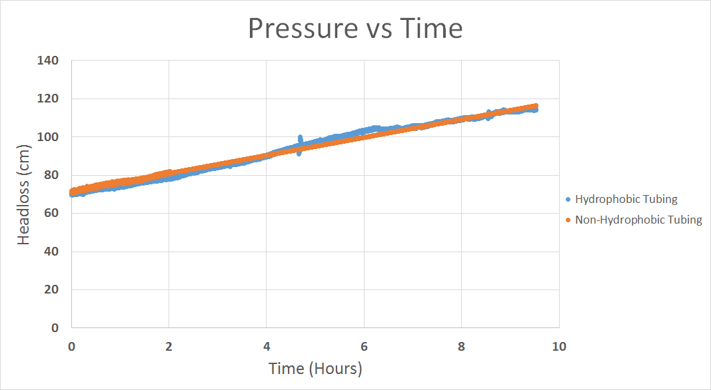
Effect of Hydrophobic tubing on pressure build up
High G Flocculation | Research | Symposiums Presentation Spring 2018
Notes:
Image Source:https://github.com/AguaClara/high_g_flocculation/blob/master/HighGFlocculation_Spring2018_ResearchReport.md
Graph Comparing Hydrophobic and Regular Tubing.
When conducting the experiment comparing the headloss in identical experiments with solely changing the tubing from regular (non-hydrophobic) tubing to hydrophobic tubing, the trial yield achieved the following results.The results showed an insignificant difference in headloss reduction. In both experiments, the trial started at around 70cm and after 10 hours reached 120cm at a constant rate. This showed that the hydrophobic tubing was ineffective at minimizing headloss due to the coagulant.

Slide 11
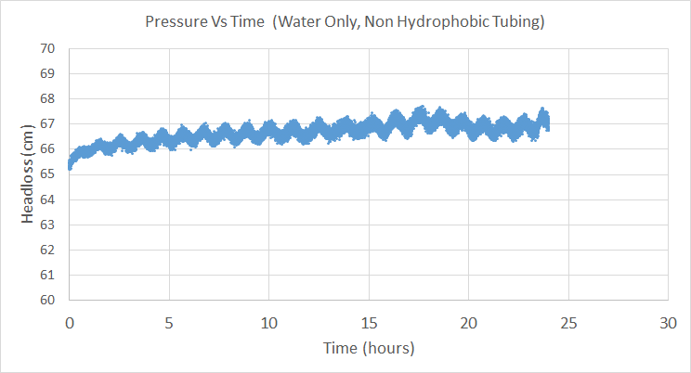
Control Experiment with Water Only
High G Flocculation | Research | Symposiums Presentation Spring 2018
Notes:
Cite your sources here.
Caption your figure and explain its relevance to your presentation/thesis here. You can take the caption from your Final Report and modify it.
Write a summary of this slide here. A future team member or client should be able to read this note and understand this slide without having your team explain it to them.
If there are any appendix slides that are relevant to this slide, mention it in your notes.

Slide 12
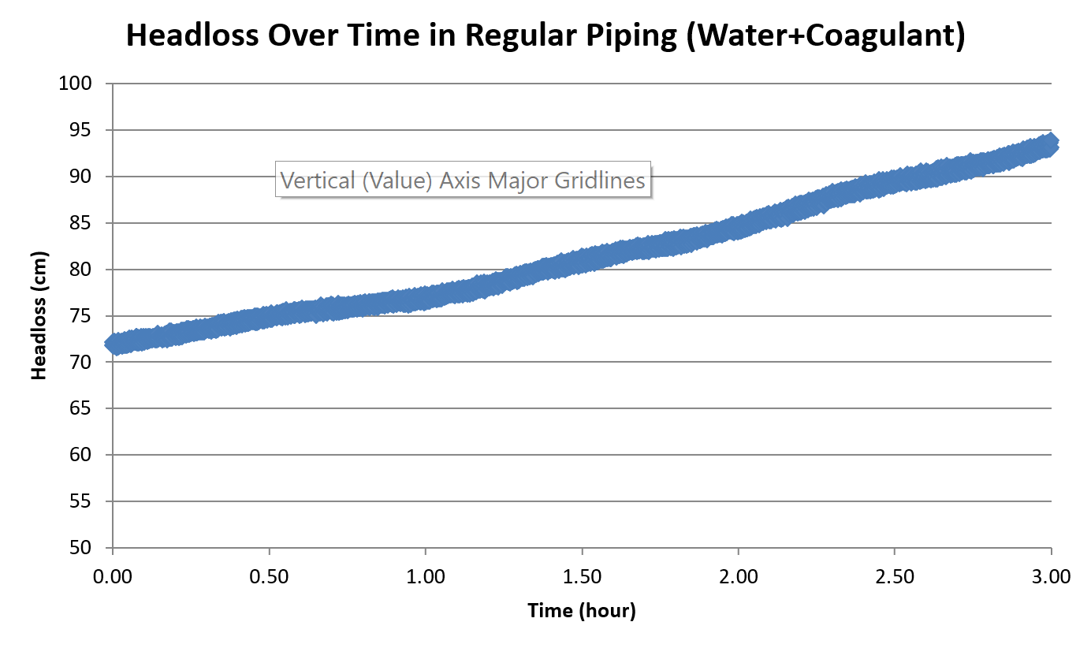
Coagulant shows an impact on pressure build up
High G Flocculation | Research | Symposiums Presentation Spring 2018
Notes:
Cite your sources here.
Caption your figure and explain its relevance to your presentation/thesis here. You can take the caption from your Final Report and modify it.
Write a summary of this slide here. A future team member or client should be able to read this note and understand this slide without having your team explain it to them.
If there are any appendix slides that are relevant to this slide, mention it in your notes.

Slide 13
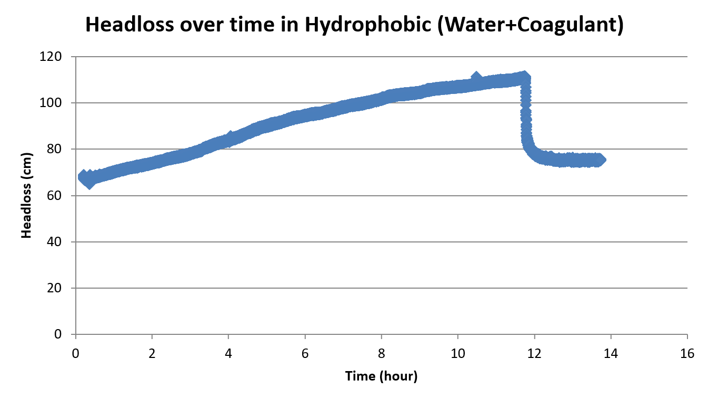
Effect of Coagulant on Pressure (No Clay)
High G Flocculation | Research | Symposiums Presentation Spring 2018
Notes:
Cite your sources here.
Caption your figure and explain its relevance to your presentation/thesis here. You can take the caption from your Final Report and modify it.
Write a summary of this slide here. A future team member or client should be able to read this note and understand this slide without having your team explain it to them.
If there are any appendix slides that are relevant to this slide, mention it in your notes.

Slide 14
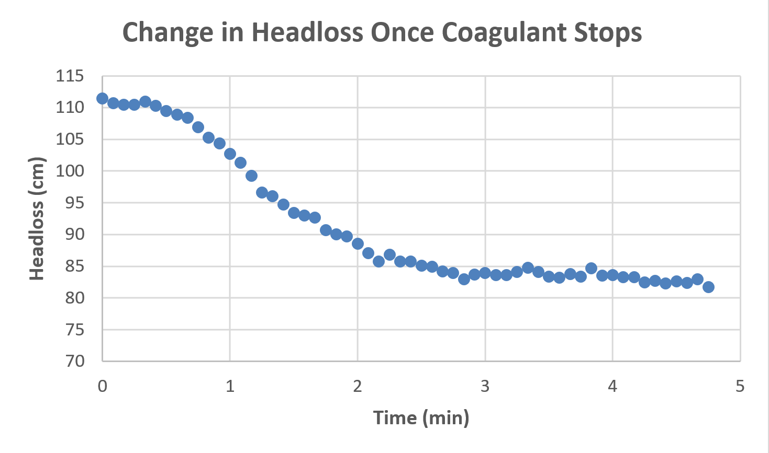
Pumping air bubbles may reduce pressure build up
High G Flocculation | Research | Symposiums Presentation Spring 2018
Notes:
Image Source:https://github.com/AguaClara/high_g_flocculation/blob/master/HighGFlocculation_Spring2018_ResearchReport.md
This loss in pressure could be due to the pumping in of air bubbles as the coagulant pump continued to run.

Slide 15
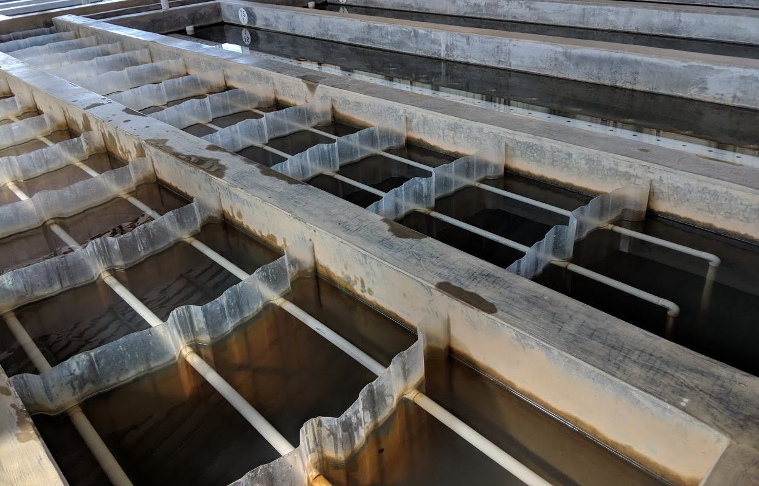
Current Conclusions
Hydrophobic tubing is insignificant in reducing pressure build up
Coagulant has an impact on pressure build up
High G Flocculation | Research | Symposiums Presentation Spring 2018
Notes:
Cite your sources here.
Caption your figure and explain its relevance to your presentation/thesis here. You can take the caption from your Final Report and modify it.
Write a summary of this slide here. A future team member or client should be able to read this note and understand this slide without having your team explain it to them.
If there are any appendix slides that are relevant to this slide, mention it in your notes.

Slide 16
Future Work
Evaluate whether pressure build up can be mitigated by running the water pump at full speed for a short time.
Determine an optimal G value by running trials at G values lower than 100 Hz.
Conduct experiments to determine a relationship between coagulant dose and optimal G through varied coagulant dose trials.
High G Flocculation | Research | Symposiums Presentation Spring 2018
Notes:
Cite your sources here.
Caption your figure and explain its relevance to your presentation/thesis here. You can take the caption from your Final Report and modify it.
Write a summary of this slide here. A future team member or client should be able to read this note and understand this slide without having your team explain it to them.
If there are any appendix slides that are relevant to this slide, mention it in your notes.

Slide 17
Questions
and
Recommendations
Roswell Lo // rl732@cornell,edul
Mehrin Selimgir // ms3442@cornell.edu
Kanha Matai // km694@cornell.edu
High G Flocculation | Research | Symposiums Spring 2018

Slide 18
Make sure you are using your team color
Appendix
Slides
Make sure you are using your team color
Team Name | Research | Symposiums Presentation Spring 2018
Notes:
From this point on, add any slides with figures that will help support your thesis. You might pull these figures from your Final Report.

Slide 19
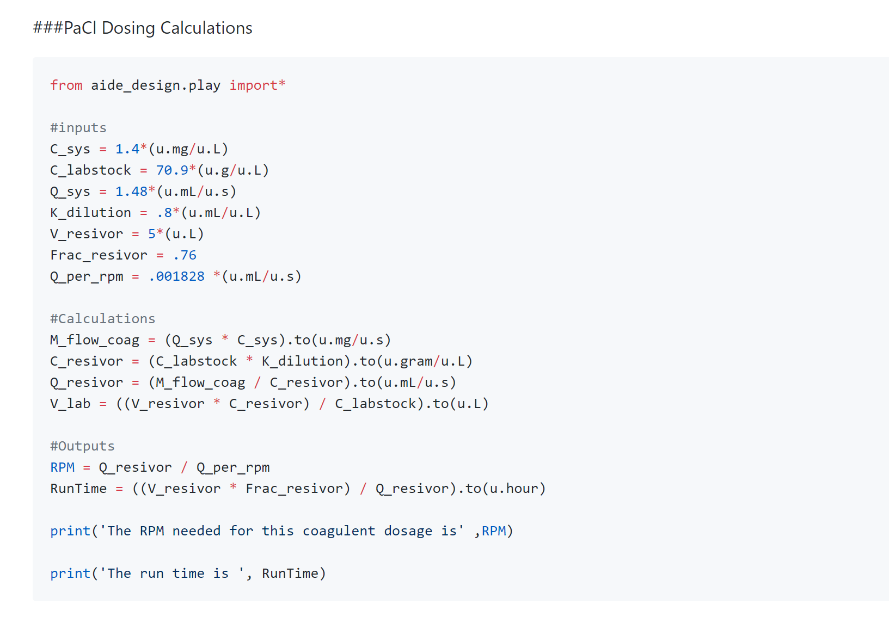
Appendix 1: Python Code
PaCl Dosing Calculations
High G Flocculation | Research | Symposiums Presentation Spring 2018
Notes:
Cite your sources here.
Caption your figure and explain its relevance to your presentation/thesis here. You can take the caption from your Final Report and modify it.
Write a summary of this slide here. A future team member or client should be able to read this note and understand this slide without having your team explain it to them.

Slide 20
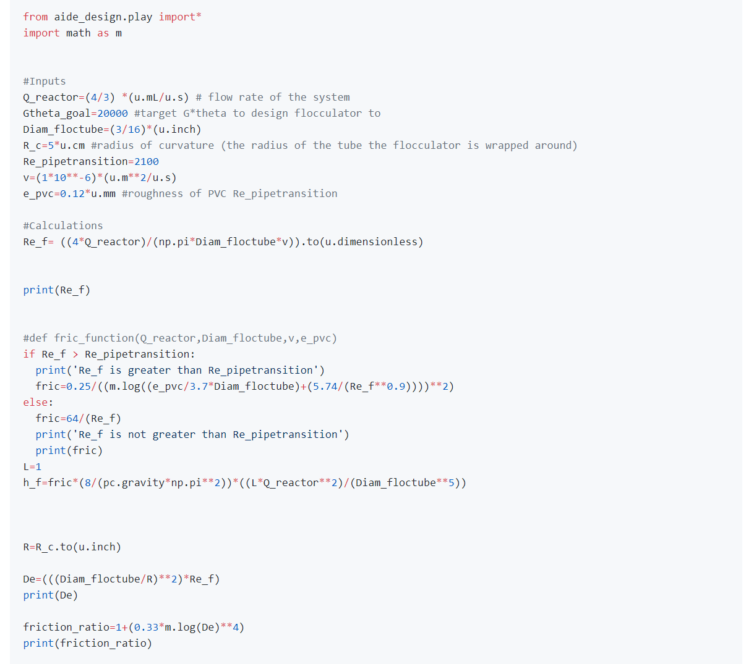
Appendix 2: Python Code
Flocculator Design Calculations
High G Flocculation | Research | Symposiums Presentation Spring 2018
Notes:
Cite your sources here.
Caption your figure and explain its relevance to your presentation/thesis here. You can take the caption from your Final Report and modify it.
Write a summary of this slide here. A future team member or client should be able to read this note and understand this slide without having your team explain it to them.

Slide 21
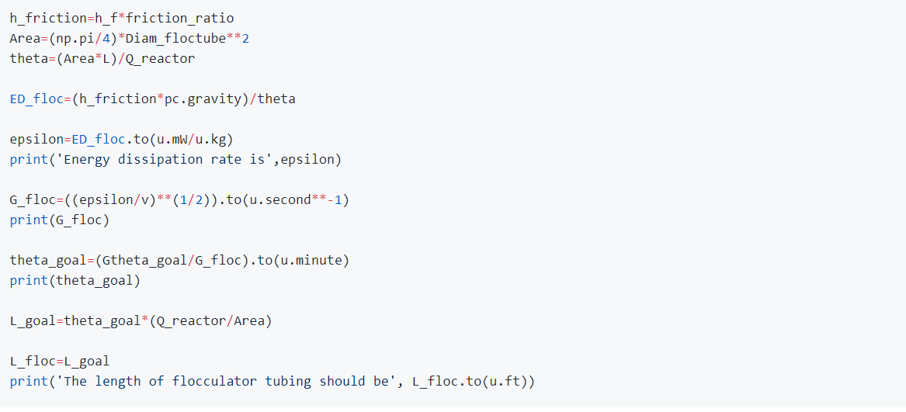
Appendix 2 (Cont.)
Flocculator Design Calculations
High G Flocculation | Research | Symposiums Presentation Spring 2018
Notes:
Cite your sources here.
Caption your figure and explain its relevance to your presentation/thesis here. You can take the caption from your Final Report and modify it.
Write a summary of this slide here. A future team member or client should be able to read this note and understand this slide without having your team explain it to them.

Slide 22
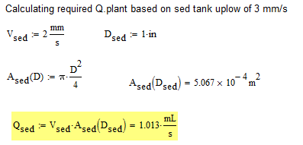
Appendix 3:
The upflow velocity in the tube settler needs to be fixed (2mm/s) to allow formation of a floc blanket
High G Flocculation | Research | Symposiums Presentation Spring 2018
Notes:
Equation Source: Cornell CEE 4540 lecture slides, Flocculator Model.
Calculations for the constant sedimentation tank flow rate based on required velocity for a floc blanket and inner diameter.

